Slide 1
Overview
History of Representative Species in the Service’s Northeast Region
Notes:
The history of representative species in this region starts with the
Strategic Habitat Conservation NEAT Report
Northeast Region Strategic Habitat Conservation Concept Plan
Northeast Region SHC Team Representative Species Proposal
UMass contract
North Atlantic LCC Project

Slide 2
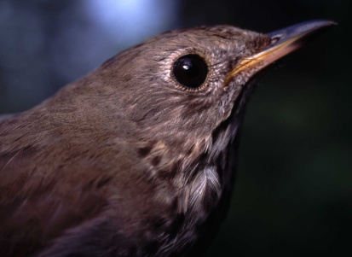

Why do we need Representative Species?
To help develop maps, tools and
landscape designs focused on
providing habitat for multiple species
To help understand the current and
future capability of landscapes to
support fish and wildlife populations
To help guide strategic decisions
about how much of what habitat
conservation actions are needed
where to sustain populations

Slide 3
What Is a Representative Species?
As defined by NALCC
..a species whose habitat needs, ecosystem function, or management responses are similar to a group of other species.
  It is assumed that conservation planning and actions for a representative species will also address the needs of other species.
Notes:
Throughout the process of developing representative species it was recognized that there was a need to plan for stand-alone species that have unique habitat or ecosystem function; are needed to prioritize management actions; or are needed to help achieve a more comprehensive suite of species for biodiversity conservation.

Slide 4
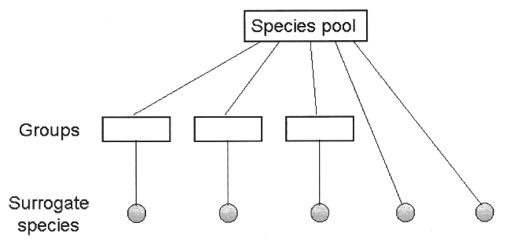
Representative Species Process
  Compile list of priority species
  Develop species-habitat association database
  Conduct cluster & indicator species analyses
  Develop ranking criteria
  Conduct region-wide workshops
Habitat Clusters
Representative Species
Notes:
Compile list of priority species
Develop species-habitat-guild matrices for each priority species using the terrestrial & aquatic habitat classification systems developed by TNC.
Use cluster & indicator species analyses to identify species most closely associated with suites of ecological habitat for consideration as potential representative species (UMASS)
Conduct region-wide workshops to review & select final sets of representative species for the region
This suite of representative species will be used in the next steps of biological planning and conservation design.

Slide 5
Selecting Representative Species & Habitats
Reduce the numbers of priority species & habitat systems in the classification
Identify suites of representative species for biological planning & conservation design
Priority Species n=291
Species-Habitat Groups
Species-
Habitat
Systems
Species-
Habitat
Systems
Species-
Habitat
Systems
Species-
Habitat
Systems
Rep Species

Slide 6
Priority Species List
Priority species lists provided by FWS & SGCN (total = 411)
  - terrestrial (341)
  - aquatic (70)
  - threatened and endangered (106)
  - SGCN (32)
Dropped 120 species for various reasons
  extirpated from or does not occur in NALCC
  exclusively marine
  of concern only in BCR 27 (southern boundary of NALCC)
  occurs only in BCR 27 and/or 28
  distribution too localized or no threats
  unreviewed or incomplete review by experts
Notes:
Extirpated-Gray wolf
Does not occur-Wood stork & many mussels
Marine-Whales
BCR 27 concern only - swallow-tailed kite
BCR 27 & 28 – Lark sparrow
Local distrib or No threat – cave isopods,
Unreviewed/incomplete-Plants, inverts, handful of birds

Slide 7
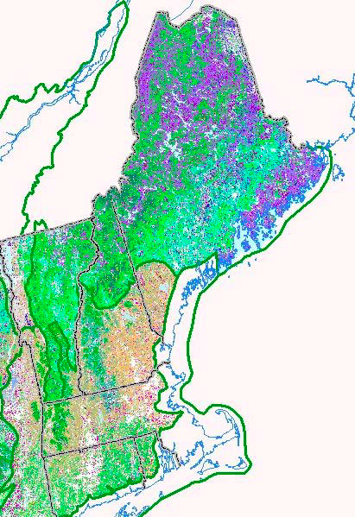
Habitat Classification - Terrestrial
TNC - NE Wildlife Habitat Classification & Mapping Project
Hierarchical classification
144 habitat systems
Notes:
Another part of the history of representative species was the development by the Northeast States working with TNC of a consistent habitat aquatic and terrestrial habitat classification and maps developed for the whole region.
The 13 Northeastern States through NEAFWA agreed that a standardized habitat classification system was necessary to in order to have “apples to apples” comparisons throughout the Region and set conservation actions that cut across State boundaries.
As such, the standardized habitat classification system, both terrestrial and aquatic was used to link species to habitats.

Slide 8
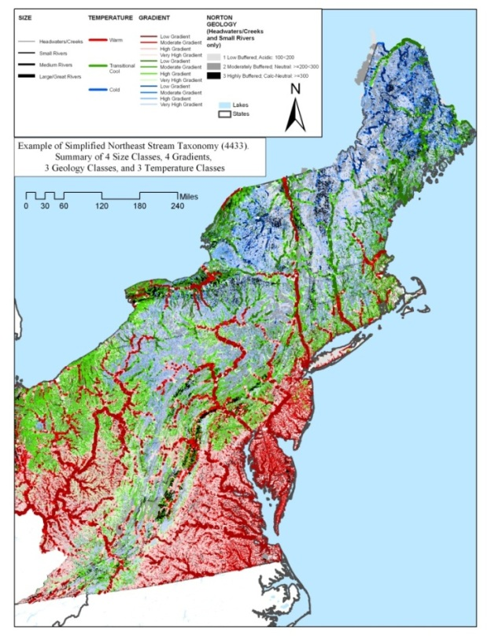
Habitat Classification
TNC – NE Aquatic Habitat Classification
92 simplified aquatic habitat types
  Size
  gradient
  geologic setting & buffering capacity
  temperature
No lake habitat classification developed (size dataset)
No marine/estuarine systems

Slide 9
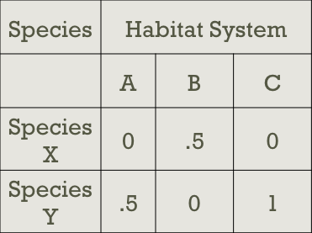
Species Habitat Matrices
Supplementary habitats added to fill in gaps in TNC classifications
Designated breeding and non-breeding habitats
Preferred and utilized habitat use values
Utilized online databases and current literature
0 = not utilized, 0.5 = utilized, 1 = preferred
Notes:
Species-habitat association matrices were developed for the 291 potential representative species using the habitat systems defined in the Northeastern Terrestrial Wildlife Habitat Classification (Gawler 2008) and Northeastern Aquatic Habitat Classification (Olivero & Anderson, 2008), both developed by NatureServe and The Nature Conservancy for the Northeast Association of Fish & Wildlife Agencies (NEAFWA). The matrices were developed using online databases (i.e. NatureServe, Birds of North America) and current literature.
A suite of supplementary habitats was added to fill in habitat gaps in both the terrestrial and aquatic
classification systems.
For terrestrial species, seasonal use of habitats was identified as breeding and non-breeding, and habitats were classified as either preferred habitat (primary) or utilized habitats (secondary).
Gawler, S. C. 2008. Northeastern Terrestrial Wildlife Habitat Classification. Report to the Virginia Department of Game and Inland Fisheries on behalf of the Northeast Association of Fish and Wildlife Agencies and the National Fish and Wildlife Foundation. NatureServe, Boston, Massachusetts. 102 pp.
Olivero, A.P. and M. G. Anderson. 2008. Northeast Aquatic Habitat Classification. The Nature Conservancy, Boston, Massachusetts. 86 pp.

Slide 10
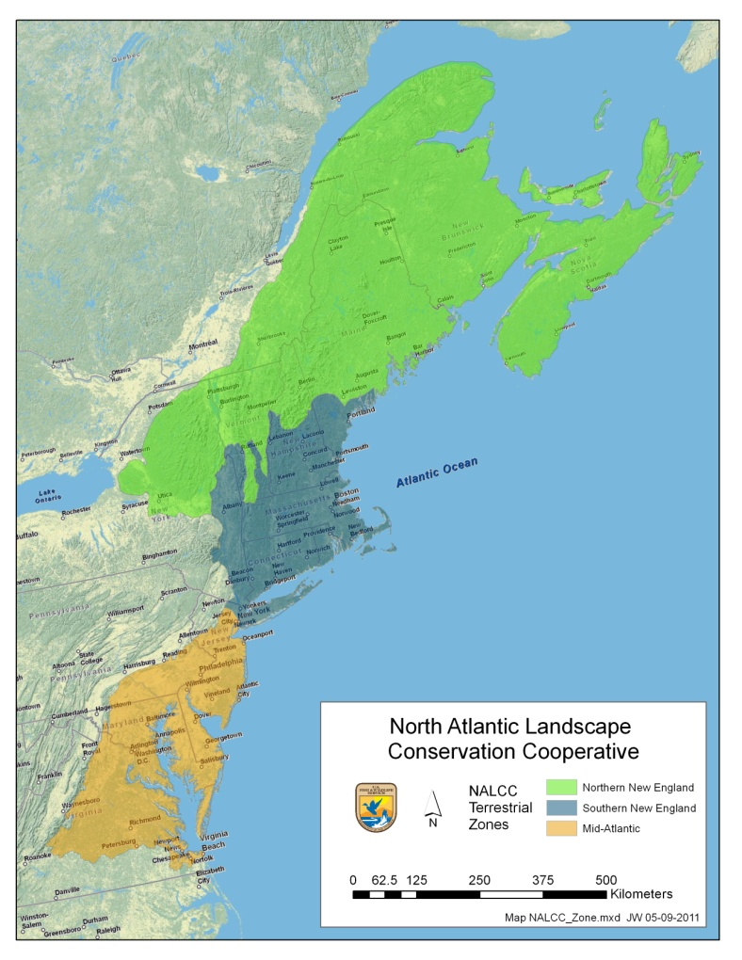
Cluster Analysis
Separate analyses for terrestrial and aquatic species
Species were divided into separate breeding and non-breeding ‘species’for those that use different suites of habitats seasonally
Divided NALCC into 3 sub-regions (terrestrial only)
Notes:
Cluster analysis was conducted by UMASS.
For the terrestrial species, separate analyses were conducted for each of the three subregions,
For aquatic species, a single analysis without regard to subregion was conducted. There were too few aquatic species to split them into subregional analyses
More than 50 species experts both inside and outside of the USFWS conducted an expert
review of the databases.
Each species was clustered with only one cluster group, representing the habitat systems that species is most closely associated.
If the breeding and non-breeding habitats are distinctly different for a species, the species could cluster with two separate habitat system cluster groups.
An indicator species analysis was conducted to identify those species most strongly associated with each habitat system cluster

Slide 11
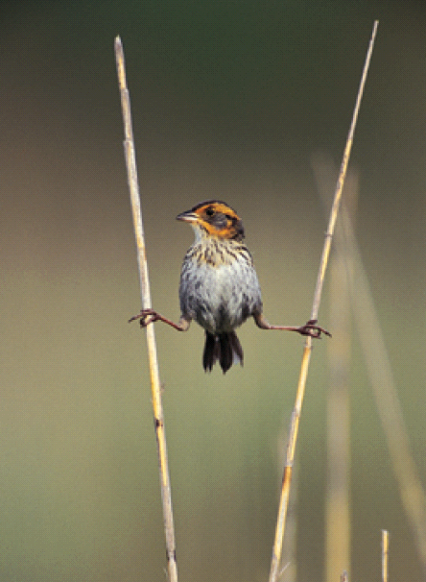
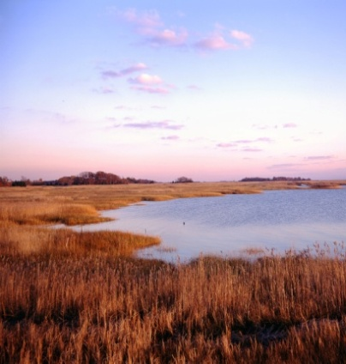
Purpose of Workshops - 2011
To bring together species and habitat experts in three sub-regions of the North Atlantic LCC area to agree on an initial set of representative species to best represent the larger set of species for the purpose of detailed conservation planning
  review cluster groups & indicator scores
  apply ranking criteria
  select final set of representative species
Notes:
Three workshops were held, one in each subregion, with federal, state, and NGO partners
to identify a list of representative species for the NALCC.
Conducted by species experts both inside and outside of FWS (~7 months to complete)

Slide 12
Workshop Fundamental Objectives
GOAL: Identify a list of representative species for designing conservation & management strategies that will most effectively sustain fish and wildlife populations at desired levels in the face of land use change, climate change, and other stressors occurring within the North Atlantic LCC
Represent as many priority species as possible with the fewest number of representative species
Maximize geographic coverage across the LCC by selecting representative species with the widest geographic distributions
Select representative species that occur across as many habitat systems as possible within the LCC

Slide 13
Filtering Criteria
Species occur over a large geographic area and represent a wide range of habitat types
Level of sensitivity to landscape configuration, disturbance, or management
Feasibility of Monitoring
Life history and population dynamics “sufficiently” known
Development or refinement of species-habitat models of species distribution and their response to environmental change
Notes:
Development of the criteria was based on the recommendations of Lambeck (1997), Miller (unpublished), and Noon (2008).
Lambeck, R. J. 1997. Focal species: a multi-species umbrella for nature conservation.
Conservation Biology 11: 849-857.
Miller, S. Selecting focal species for Strategic Habitat Conservation. Unpublished manuscript.
Noon, B. R., K. S. McKelvey, and B. G. Dickson. 2008. Multispecies conservation planning on U.S. federal lands.
Pgs 51-83.

Slide 14
Example of
Species/Habitat Cluster
Species Represented of those considered (18)
Bay-breasted Warbler
Bicknell’s Thrush
Black-backed Woodpecker
Blackburnian Warbler
Black-throated Green Warbler
Bonaparte’s Gull
Boreal Chickadee
Boreal Owl
Brown Creeper
Cape May Warbler
Gray Jay
Lynx
Northern Saw-whet Owl
Olive-sided Flycatcher
Palm Warbler
Pine Grosbeak
Purple Finch
Sharp-shinned Hawk
Habitat Types Associated with
Spruce-fir Forest
Acadian-Appalachian Montane Spruce-Fir Forest
Acadian Low-Elevation Spruce-Fir Forest and Flats
Acadian Sub-Boreal Spruce Barrens
Boreal-Laurentian Conifer Acidic Swamp
Boreal Jack Pine-Black Spruce Forest
Representative Species
American Marten
Blackpoll Warbler
Spruce Grouse
White-throated Sparrow
Notes:
22 of 291 species are associated with the 5 habitats types clustered into the Spruce-fir Forest general habitat type.
Of those 22 species, 4 were selected as reprentative species.

Slide 15
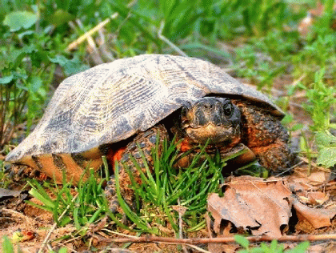
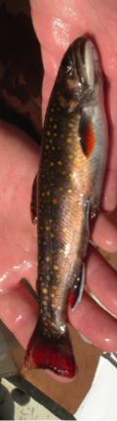
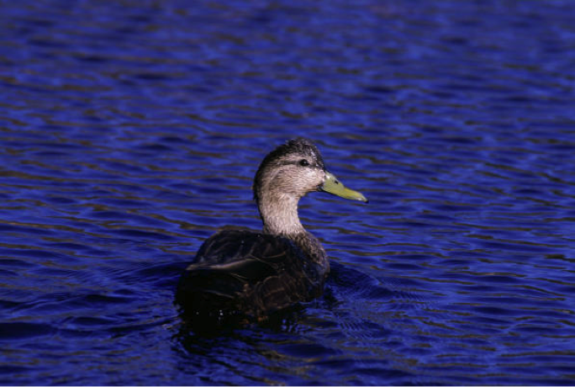
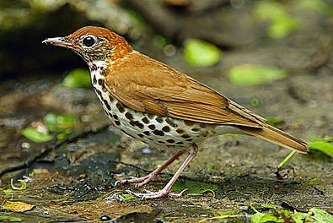
Results
87 terrestrial species selected
66 birds;
13 herps;
4 mammals;
2 plants;
2 invertebrates
12 aquatic species selected
10 fish;
1 mussel;
1 salamander

Slide 16
Lessons Learned
Lack of familiarity with TNC’s classification systems
Lack of detailed knowledge of species associations with the detailed habitat system level of classification hierarchy
Complex Aquatic habitat classification system
Not enough aquatic species identified
The NALCC boundaries did not include complete watersheds
Notes:
Lack of familiarity with the habitat classification systems, and lack of detailed knowledge of species associations with finest level of classification system hierarchy posed challenges for database development and review
The group recommended expanding the list of priority species; starting with all species listed in the state wildlife action plans that occur in the Atlantic drainage.
Participants expressed concern about the limited number of priority species, large number of habitat
classes, and lack of resident species.
Participants expressed concern about the limited number of aquatic species present on the list and that NALCC boundaries did not include complete watersheds.
The aquatic classification system is being simplified to meet managers concerns (State and Federal). Additionally, habitat gaps in the coastal estuarine classification are being added.
For aquatic species, a single analysis without regard to subregion was conducted. There were too few aquatic species to split them into subregional analyses.

